Slide 1



IPV4 and
IPV6
Jeevanantham V (2021506031)
Dept., of Information Technology

Slide 2
﻿Table Of Contents
1
Introduction of IP Addressing
2
Types of IP Address and its formats with the examples
3
Benefits of IPV6 Over IPV4
4
Differences between IPV4 & IPV6
5
Reserved ports

Slide 3

﻿IP ADRESSING
The address through which any computer communicates with our computer is simply called an Internet Protocol Address or IP address. For Example, If we want to load a web page or we want to download something, we require the address for delivery of that particular file or webpage. That address is called an IP Address.

Slide 4
Types of IP Address
IPv4 (Internet Protocol Version 4)
IPv6 (Internet Protocol Version 6)

Slide 5
IPV4 :
IPv4 address consists of two things that are the network address and the host address. It stands for Internet Protocol version four. It was introduced in 1981 by DARPA and was the first deployed version in 1982 for production on SATNET and on the ARPANET in January 1983.
IPv4 addresses are 32-bit integers that have to be expressed in Decimal Notation. It is represented by 4 numbers separated by dots in the range of 0-255, which have to be converted to 0 and 1, to be understood by Computers. For Example, An IPv4 Address can be written as 189.123.123.90.

Slide 6
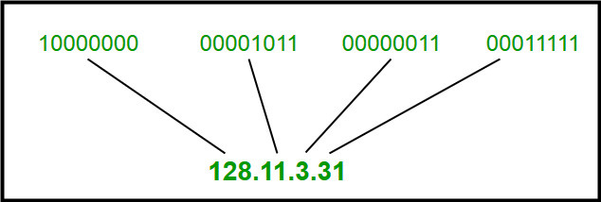
IPv4 Address Format :
IPv4 Address Format is a 32-bit Address that comprises binary digits separated by a dot (.).
IPv4 Address Format

Slide 7
IPV6 :
IPv6 is based on IPv4 and stands for Internet Protocol version 6. It was first introduced in December 1995 by Internet Engineering Task Force.
IP version 6 is the new version of Internet Protocol, which is way better than IP version 4 in terms of complexity and efficiency. IPv6 is written as a group of 8 hexadecimal numbers separated by colon (:). It can be written as 128 bits of 0s and 1s.

Slide 8
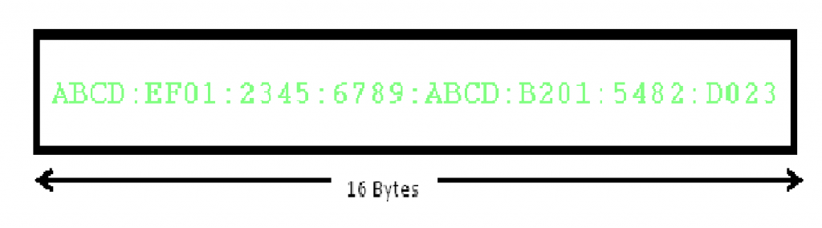
IPv6 Address Format :
IPv6 Address Format is a 128-bit IP Address, which is written in a group of 8 hexadecimal numbers separated by colon (:).
IPv6 Address Format

Slide 9
BENEFITS OF IPV6 OVER IPV4:
The recent Version of IP IPv6 has a greater advantage over IPv4. Here are some of the mentioned benefits:
Larger Address Space: IPv6 has a greater address space than IPv4, which is required for expanding the IP Connected Devices. IPv6 has 128 bit IP Address rather and IPv4 has a 32-bit Address.
Improved Security: IPv6 has some improved security which is built in with it. IPv6 offers security like Data Authentication, Data Encryption, etc. Here, an Internet Connection is more Secure.

Slide 10
Simplified Header Format: As compared to IPv4, IPv6 has a simpler and more effective header Structure, which is more cost-effective and also increases the speed of Internet Connection.
Prioritize: IPv6 contains stronger and more reliable support for QoS features, which helps in increasing traffic over websites and increases audio and video quality on pages.
Improved Support for Mobile Devices: IPv6 has increased and better support for Mobile Devices. It helps in making quick connections over other Mobile Devices and in a safer way than IPv4.

Slide 11
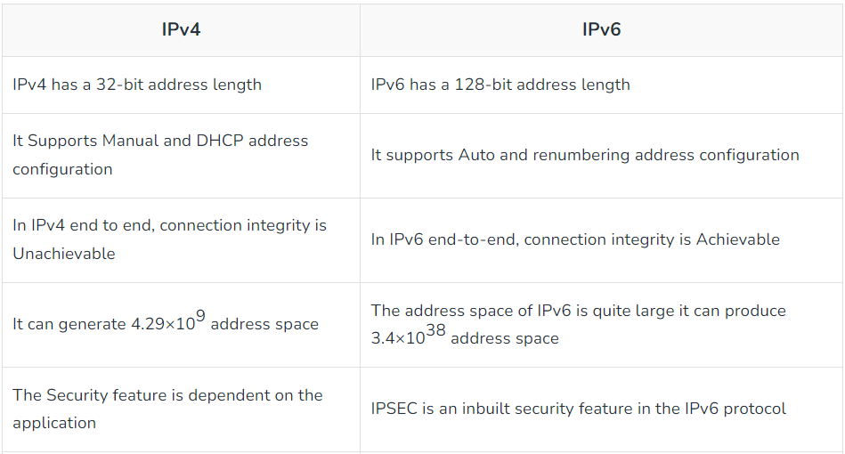
DIFFERENCES BETWEEN IPV4 & IPV6:

Slide 12
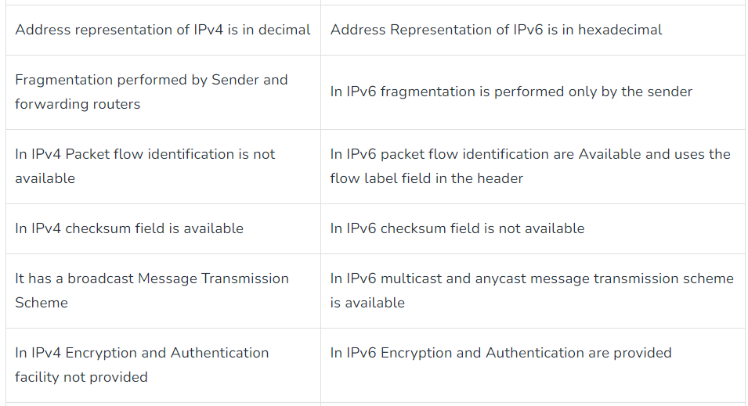

Slide 13
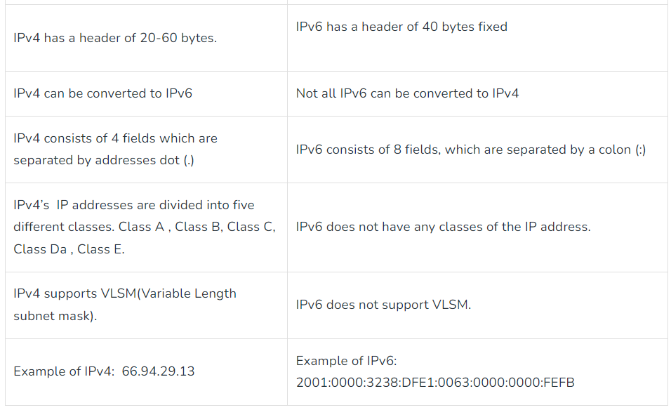

Slide 14
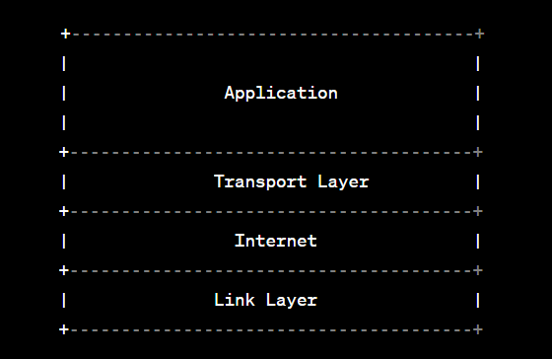
Reserved Ports:
Layers Involved in Communication Process:

Slide 15
Application Layer: This is where various applications and services reside, such as web browsers, email clients, FTP clients, etc. These applications communicate with the Transport Layer to transfer data.
Transport Layer: The Transport Layer is responsible for managing the communication between different applications running on different devices. It ensures reliable and efficient data transfer. Here we have two important protocols: TCP (Transmission Control Protocol) and UDP (User Datagram Protocol).
Internet Layer: The Internet Layer is responsible for routing data across different networks. It deals with IP addresses and handles the logical addressing of devices.

Slide 16
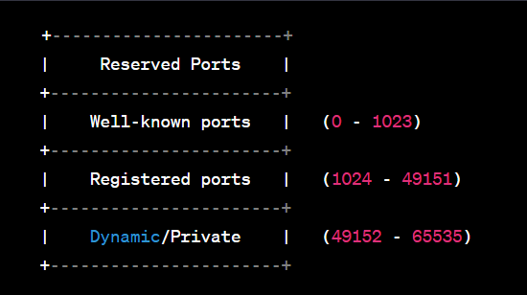
The reserved ports within the Transport Layer:
Reserved ports, also known as well-known ports, are network port numbers that have been assigned by the Internet Assigned Numbers Authority (IANA) to specific services or applications.
These ports are typically used by widely-used protocols and services for communication on the internet.
The port numbers range from 0 to 1023 and are considered "privileged" ports, meaning that they are restricted and can only be used by the system or applications with administrative privileges.

Slide 17
RESERVED PORTS :
Well-known ports: These ports are in the range of 0 to 1023. As mentioned earlier, they are reserved for well-known and widely used services, such as HTTP (port 80), HTTPS (port 443), FTP (ports 20 and 21), and so on.
Registered ports: The range of registered ports is from 1024 to 49151. These ports are used for various applications and services that are not as universally known as the well-known ports but still have been registered with IANA.
Dynamic/Private ports: The dynamic/private port range spans from 49152 to 65535. These ports are used for temporary purposes and are usually chosen dynamically by the operating system when a client application initiates a connection.

Slide 18
﻿THANK YOU

